Slide 1

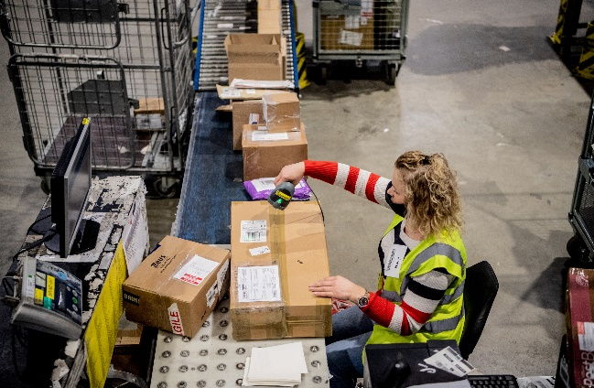

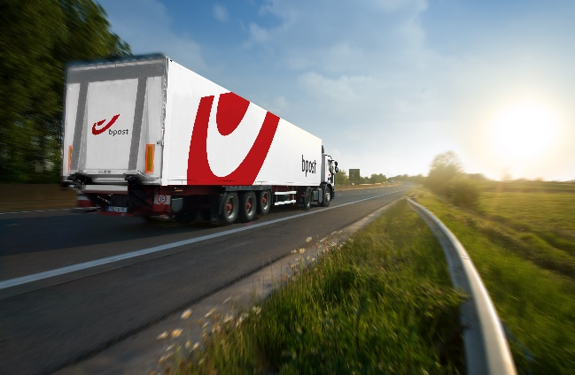
New law: Second delivery option for all webshops delivering on the Belgian Territory
When?
  From September 21st 2024, every webshop in Belgium must offer at least 2 different delivery options
Why?
  Designed to give consumers more choice & save the environment
Who?
  Every Belgian webshop and for all deliveries on the Belgian territory
Exceptions
  If only current option is in-store Pick-Up (furniture, food groceries, …)
  Young companies (<3yrs)
  Other (well-founded) reasons (jewelry, valuables, XL goods)
Highlighting the advantages of a Pick-Up point delivery:
Save up to 30% CO2 emissions
Always nearby
24/7 available (lockers)
Offering Pudo delivery cheaper / free

